Slide 1


Slide 2
Code.Fun.Do for AI IIT MADRAS

Slide 3
Agenda
Theme Introduction
Hackathon Tracks
Q&A

Slide 4
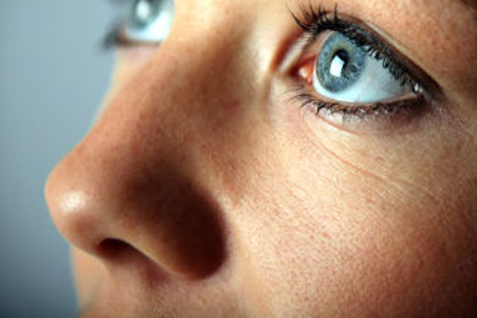
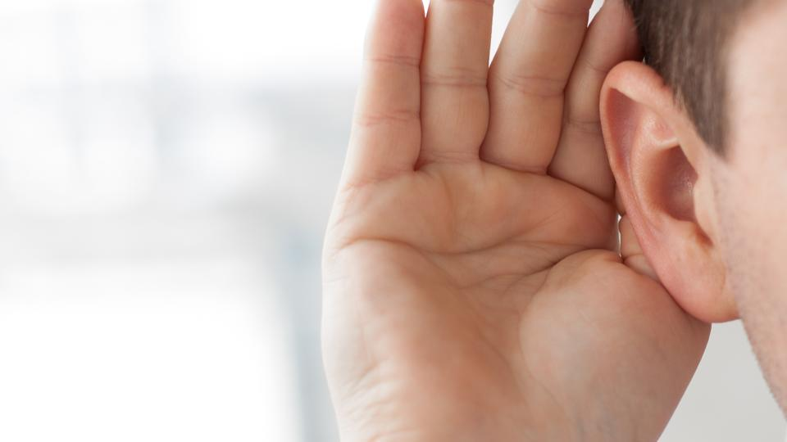
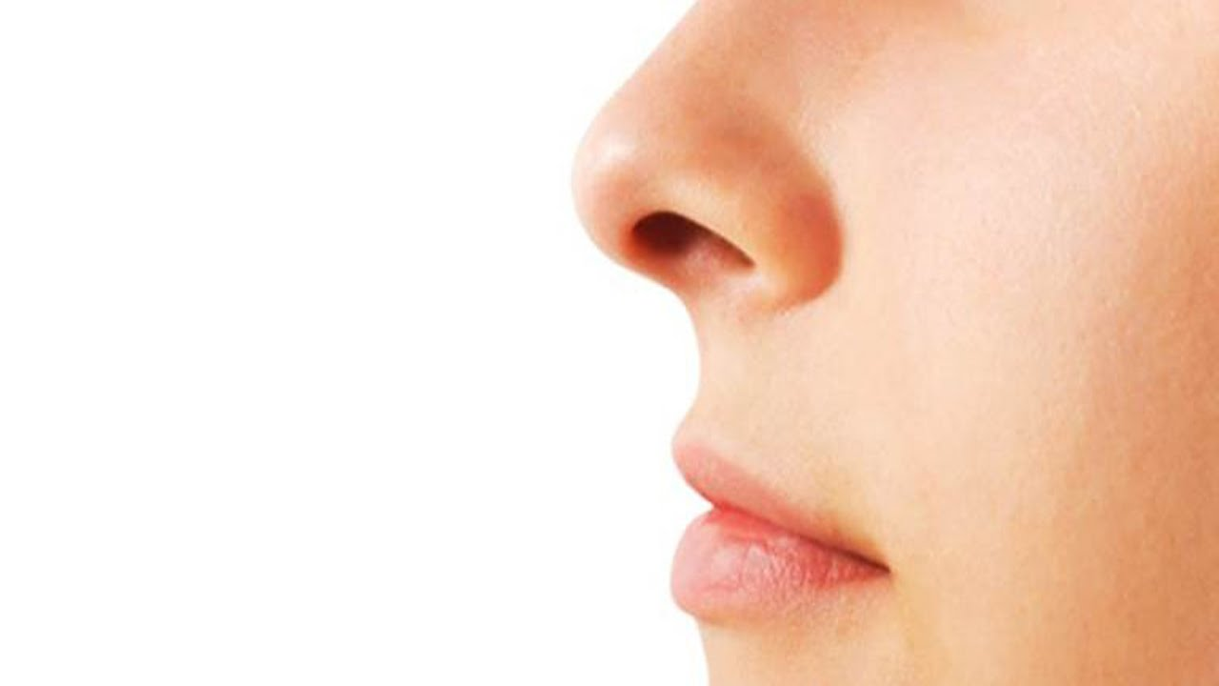
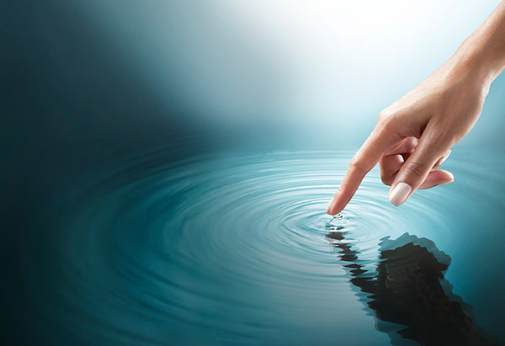
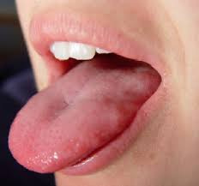
Human abilities

Slide 5
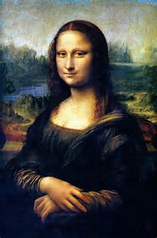
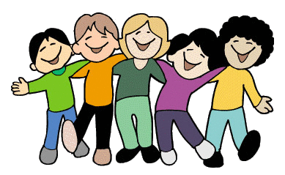
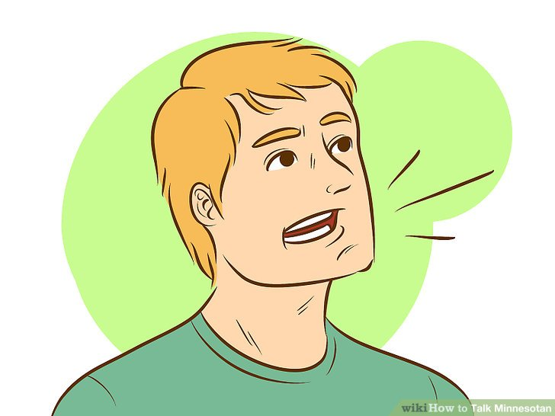
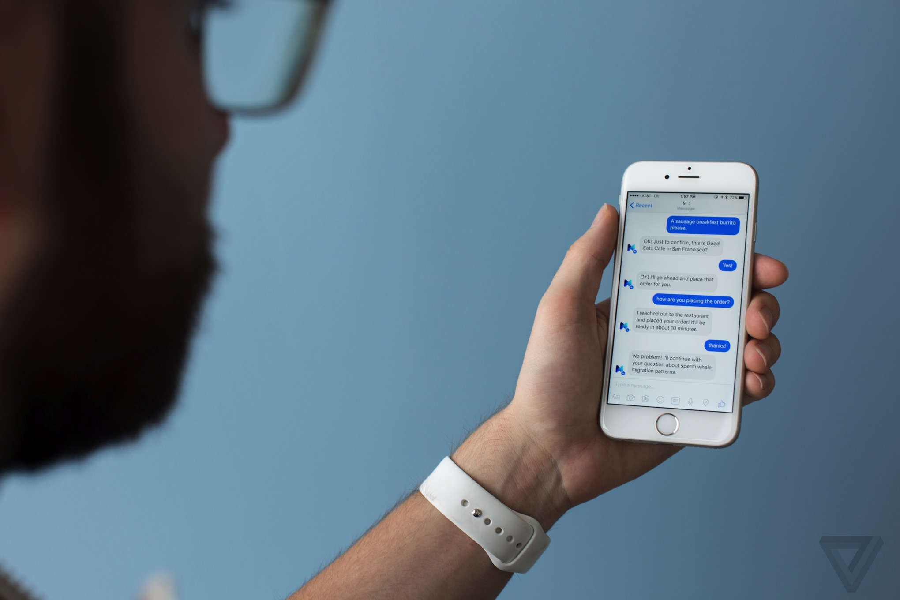
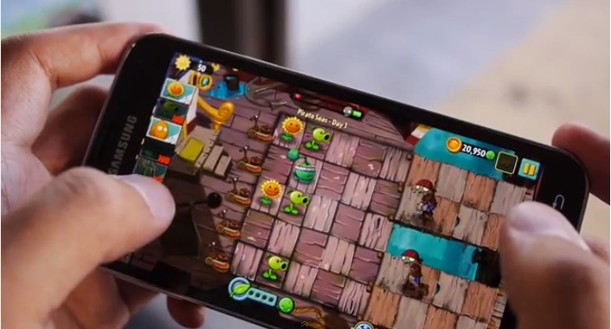
Human traits

Slide 6
Abilities of current AIs (chatbots)

Slide 7
Goal
Let’s break some more barriers

Slide 8



The Social Network
Notes:
Humans are social animal. Most of us, have tendency to share our emotions as well as daily life on social media. This track is around how to make bots social animal like humans.

Slide 9
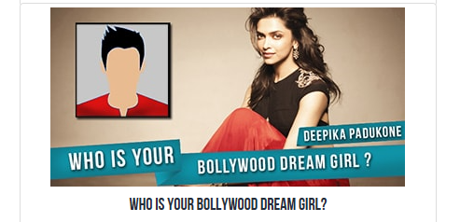
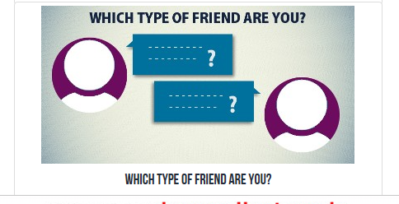
Develop chat based experiences which inherently encourages social interaction
Create a chat bot
Social interaction includes sharing / post to wall / tweets
What kind of friend are you? / Which color represent you? – inherently makes people share it with others
Notes:
Help in encouraging people to come together to talk about common interests

Slide 10
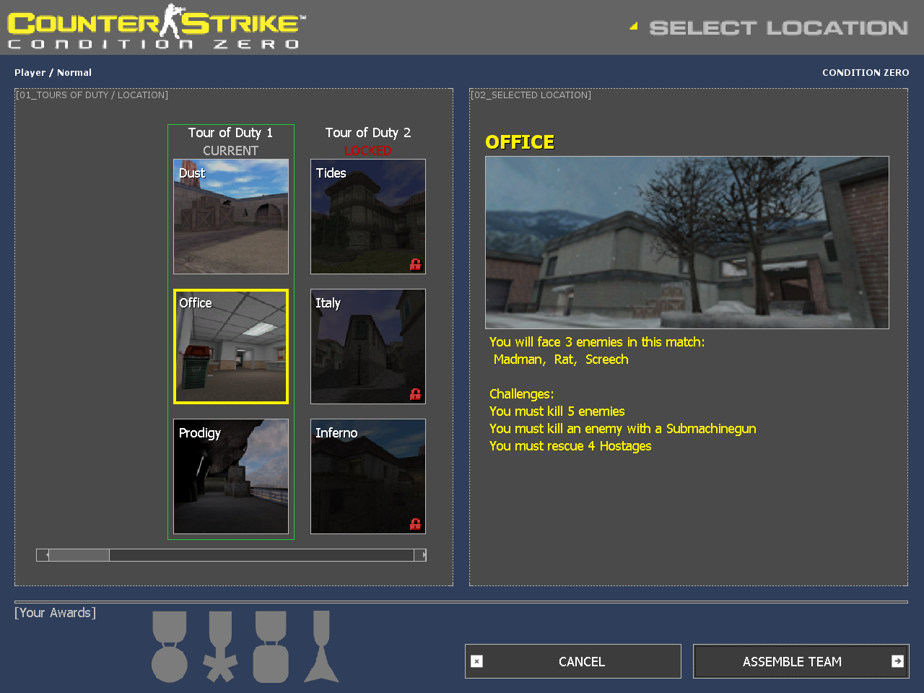
Multiplayer Games – encouraged people to create groups and play together to achieve common goals
Notes:
11iscoming

Slide 11
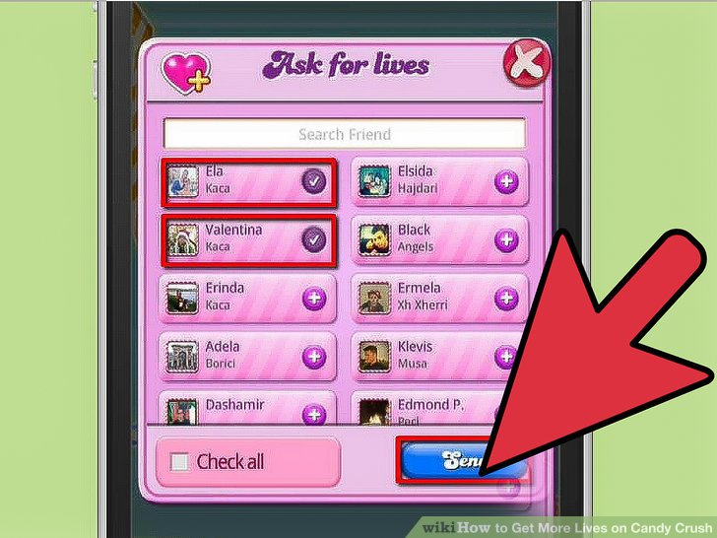
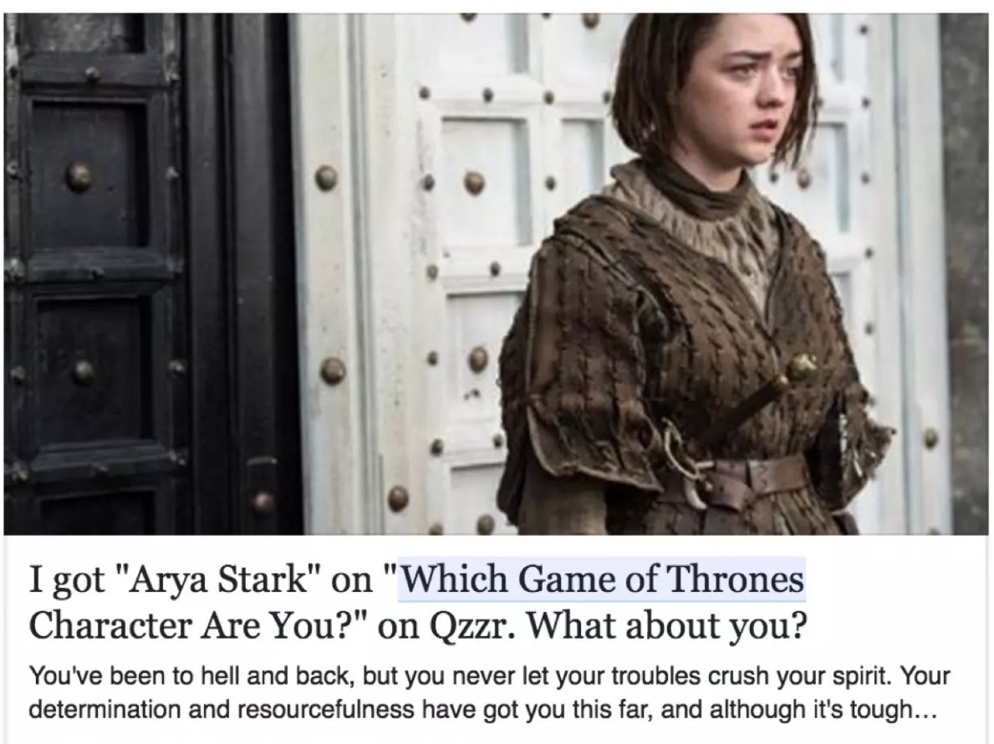
Proven Techniques to improve social interactions

Slide 12
Questions

Slide 13
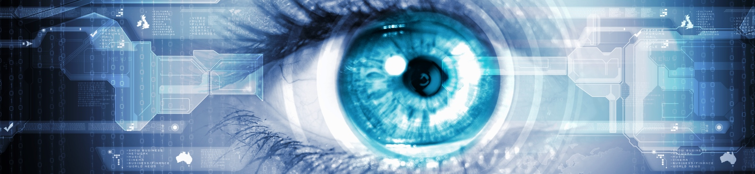
NOW YOU SEE ME
Of all the senses, sight must be the most delightful
-Helen Keller

Slide 14
What does seeing for a bot mean?
Understanding the images, gifs and videos sent to it
Not oriented to a particular task
Respond not just describe
Notes:
Some bots understand images but are restricted to specific set of tasks. For a bot, to sound human, it should understand all the different kind of images that a user sends. Also, it is important to have human touch to these responses and not just describe the image.

Slide 15
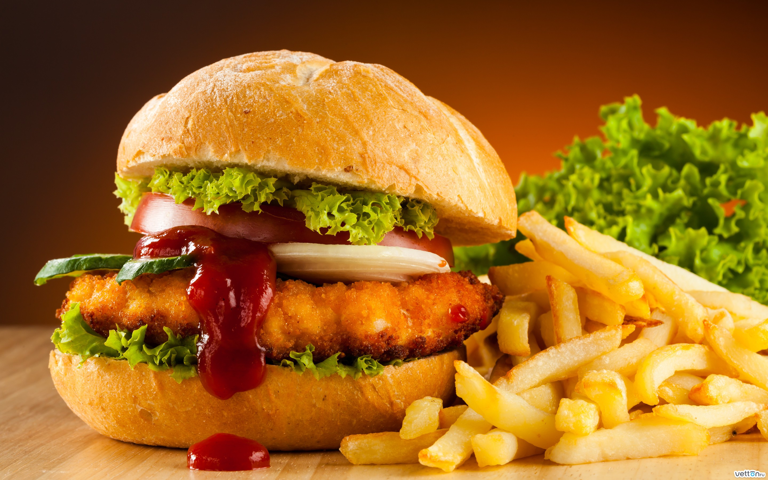
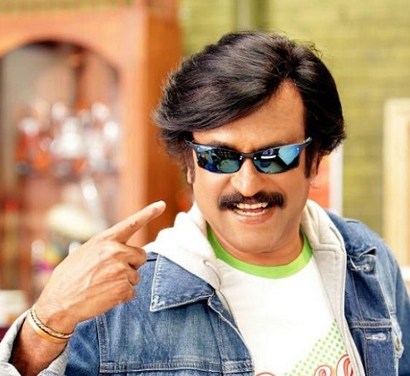
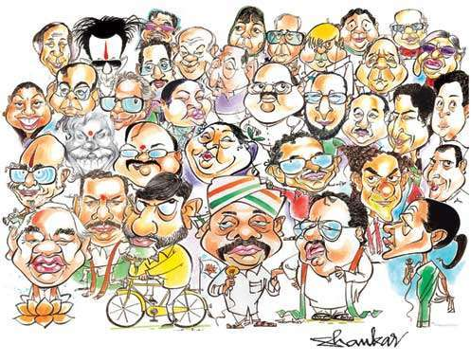
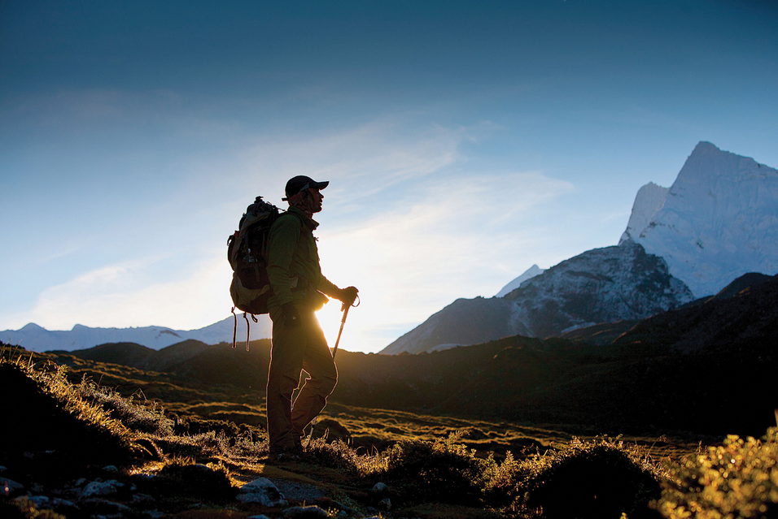
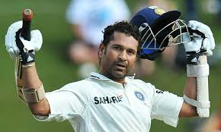
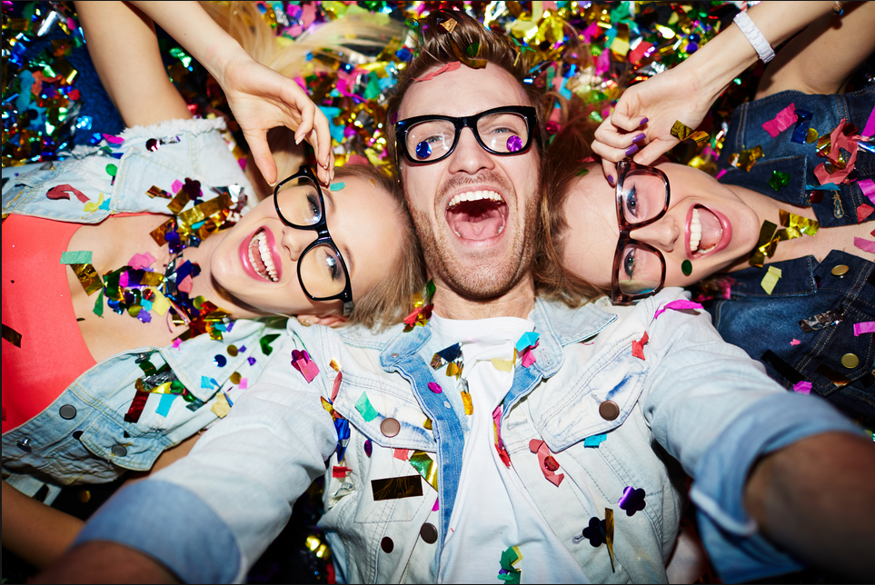

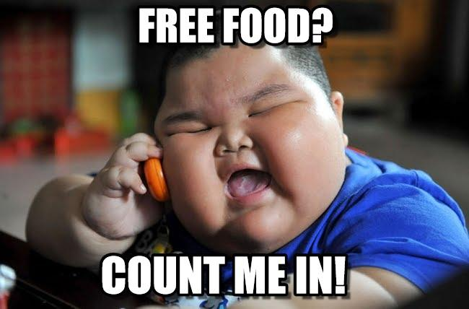
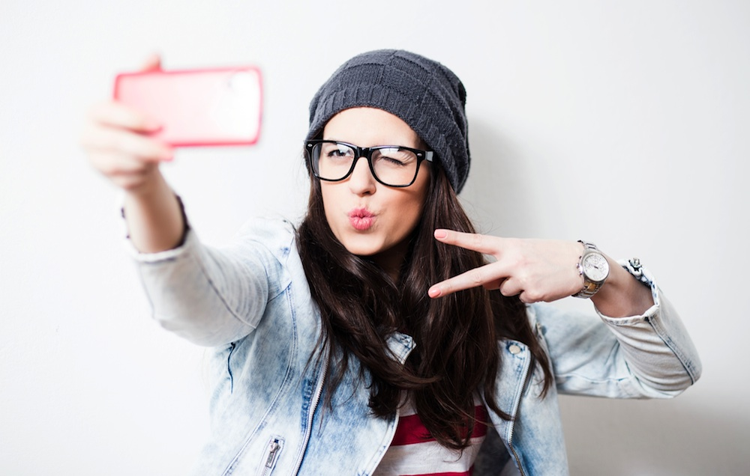
What kind of images do people generally share?
Notes:
There are different types of images that a user sends and we can build capabilities targeting individual categories and bring out user delight.

Slide 16
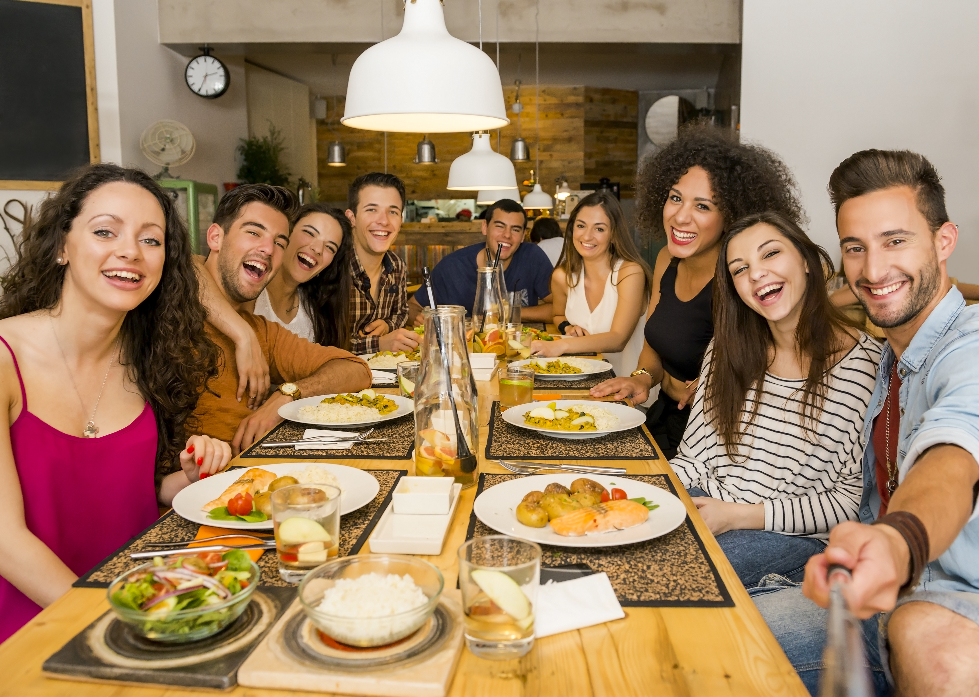
Who should pay the bill?
The oldest person in the group should pay the bill and I think he is the oldest :P
The one with the gorgeous curly hair.. <3 <3
I don’t like salad and the one eating it should pay the bill.. ;)

Slide 17
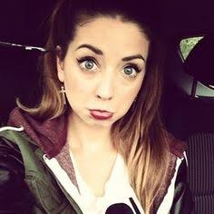
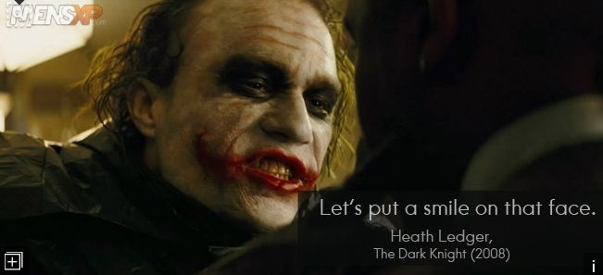
Respond with images

Slide 18

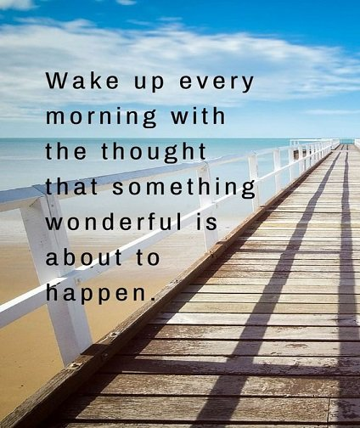
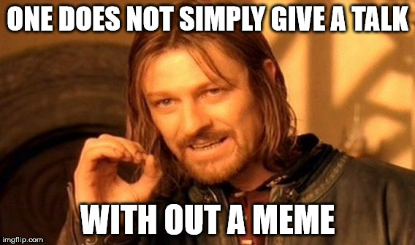
OCR

Slide 19
Questions

Slide 20
The Artist
Notes:
How many of you like to paint?

Slide 21
Art is essential part of human society.
As human, we use computers to process Art works
Can we use the same computers and algorithms to create art?
Notes:
Art - stories, lyrics, poems, music and paintings
Process art means Editing pictures / Writing and sharing Poems / Creating music using human minds
We are not asking to create mona lisa / make computer like A R Rehman. Just Assume, computer is a small kid and you want to teach him how to fill colors in a cat / dog so that it looks artistic to anyone’s eye, Or generate a poem when you give 5 random words.

Slide 22
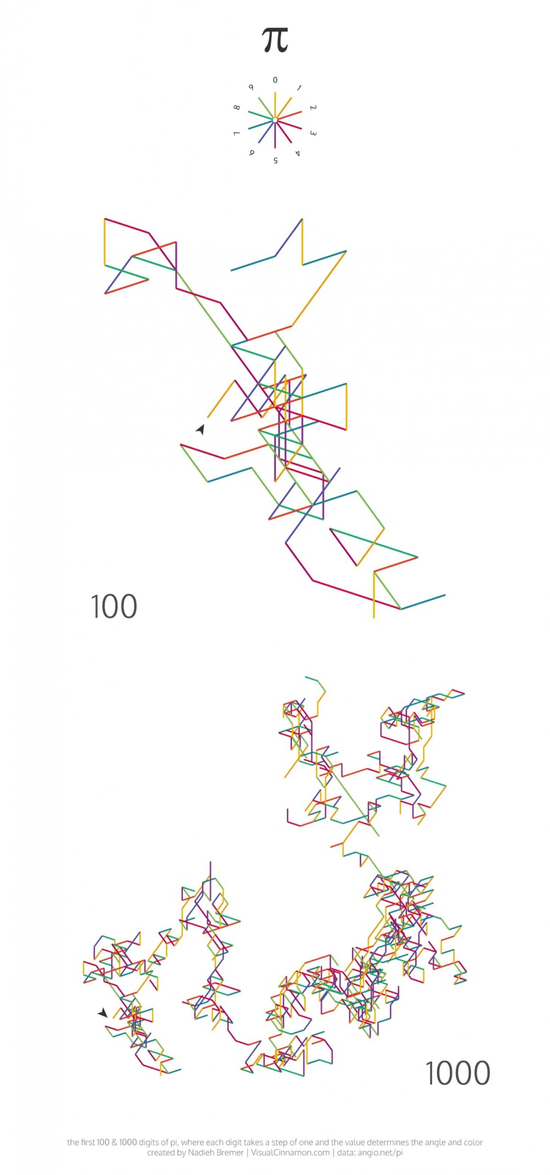
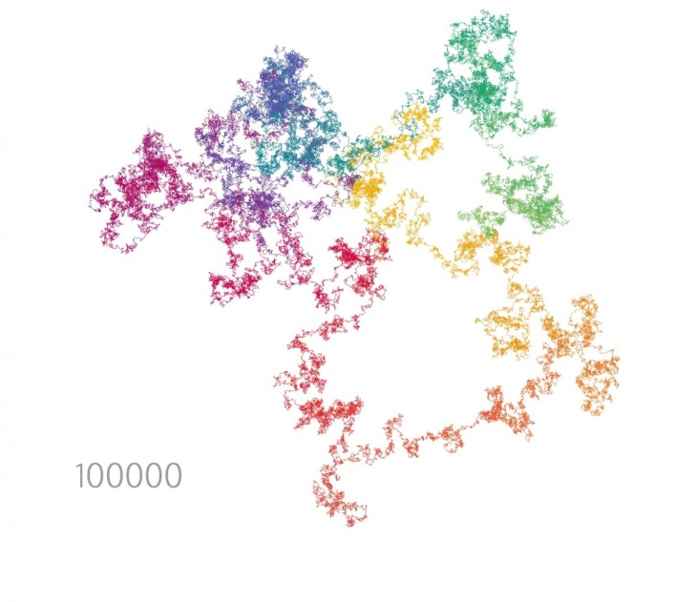

Slide 23
Create Rhymes
Input – ask users 3 words
Output – Create a rhyme that has these 3 words
Talk in a rhythm
User- wearing a long coat
Bot- rowing in a blue boat
User- running on a dark road
Bot- .. Can I join you dude?

Slide 24
Questions

Slide 25
Take away
Make bots Human-like
Git samples are at this location –
Judging criteria –
Idea
Execution
Innovation
Ask questions at IITMCFDM@microsoft.com – we mentors are here to help you.

Slide 26
Thank you

